Slide 1
INPUT AND OUTPUT FUNCTIONS IN C
Mohamed Rahman Shareff S

Slide 2
Data Input and Output
A program without any input or output has no meaning.
Input → process → Output
Ex. marks sheet of students
Reading the data from input devices and displaying the result are the two main tasks of any program

Slide 3
INPUT /OUTPUT FUNCTIONS IN C
Input/output functions are the links between the user and the terminal.
Input functions used to read data from keyboard are called standard input functions.
scanf(), getchar(),getche(),getch() etc.
Output functions used to display the result on the screen are called standard output functions.
printf(), putchar(), putch(), puts() etc.

Slide 4
INPUT /OUTPUT FUNCTIONS IN C
In C, the standard library stdio.h provides functions for input and output.
The instruction #include<stdio.h> tells the compiler to search for a file named stdio.h and places its contents at this point in the program.
The contents of the header file become part of the source code when it is compiled.

Slide 5
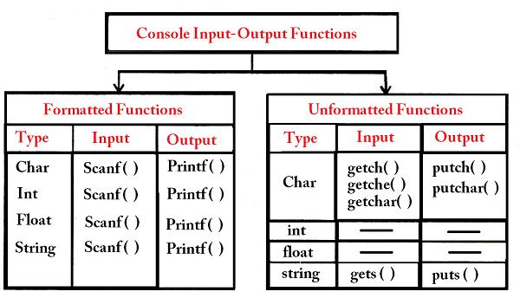

Slide 6
Formatted Functions
Formatted functions allow the input read input from the keyboard or the output displayed on screen to be formatted according to our requirements.
Input function: scanf()
Output function: printf()

Slide 7
Formatted Input
Ex: consider the following data:
– 50, 13.45, Ram
– Int, float, char variables
This is possible using the scanf function.
scanf stands for scan formatted.
The built-in function scanf() can be used to enter input data into the computer from a standard input device

Slide 8
Formatted Input
The general form of scanf is,
scanf(“control string” , arg1, arg1,….. argn);
Control string : format in which data is to be entered.
arg1,arg2… : location where the data is stored.
: preceded by ampersand (&)

Slide 9
Formatted Input
The control string consists of individual groups of data formats, with one group for each input data item.
Each data format must begin with a percentage sign.
General form of control string:
[whitespace character][ordinary character]%[field width] conversion character
Whitespace characters [optional]
Ordinary characters [Optional]
Field width [Optional]

Slide 10
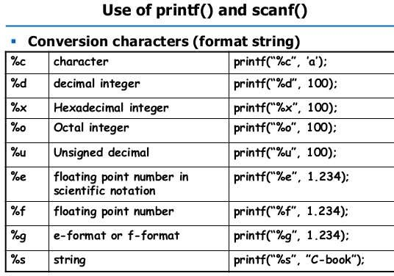

Slide 11
Formatted Output
Refers to the output of data that has been arranged in a particular format.
printf() is a built in function which is used to output data from the computer onto a standard device i.e. screen
General form: printf(“control string”,arg1,arg2,.....,arg n)
The control string consists of four types of items -
characters that will be printed on the screen as they appear.
format specifications that define the output format for display of each item
escape sequence characters such as \n, \t etc.
any combination of characters, format specifications and escape sequences.

